Slide 1

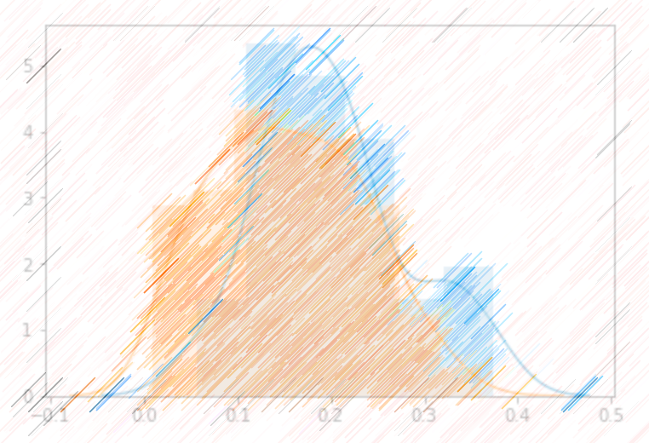
Air Traffic Passenger Counts in San Francisco Regression and Time Series Analysis
Yuyi Zhang
Notes:
It contains all non-emergence cases in San Francisco that reported through self-service online reporting system. Reports included incidents that occurred starting from January 1, 2018 to Dec 8, 2018 and have been approved by a supervising officer.

Slide 2
Agenda
Descriptive and Regression
Histogram
Density Plots
Boxplot
QQ-Plot
Linear Regression
Time Series
Decomposing
Differencing
ARIMA Model Selecting

Slide 3
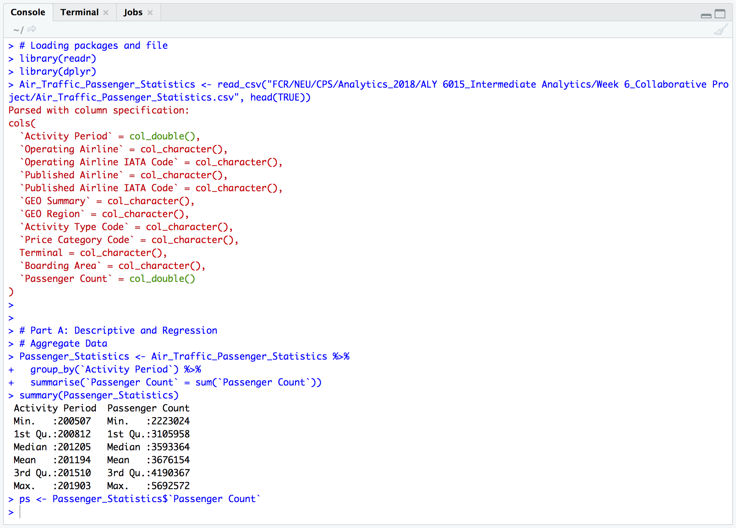
Descriptive and Regression

Slide 4
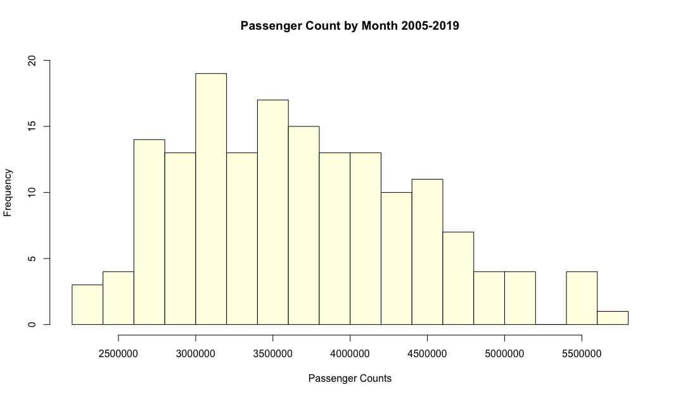
Histogram

Slide 5
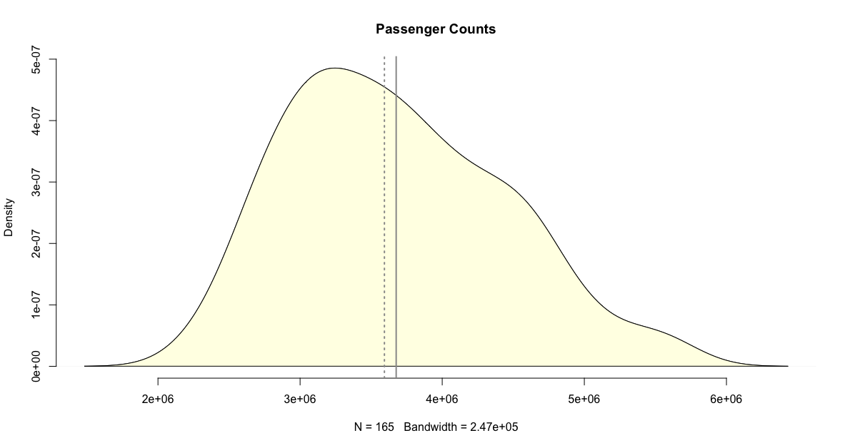
Density Plots

Slide 6
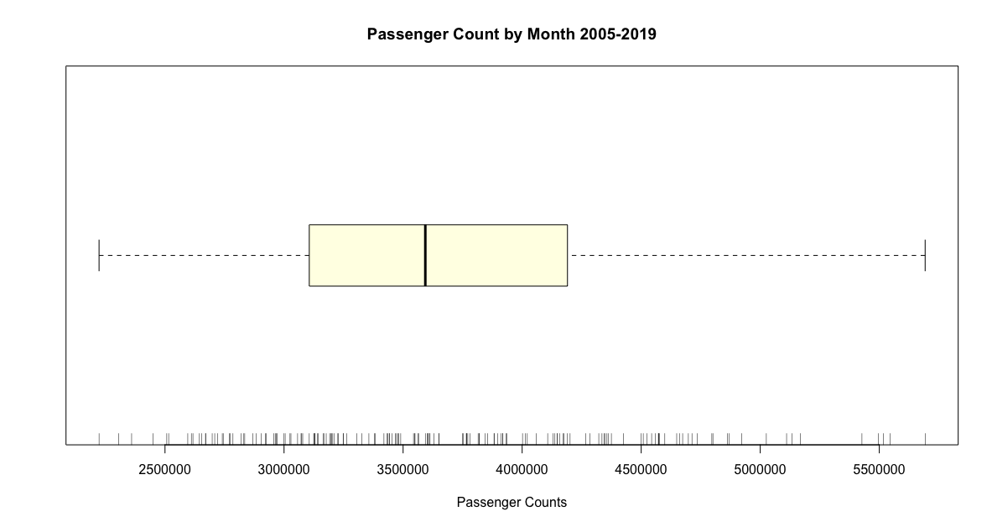
Boxplot

Slide 7
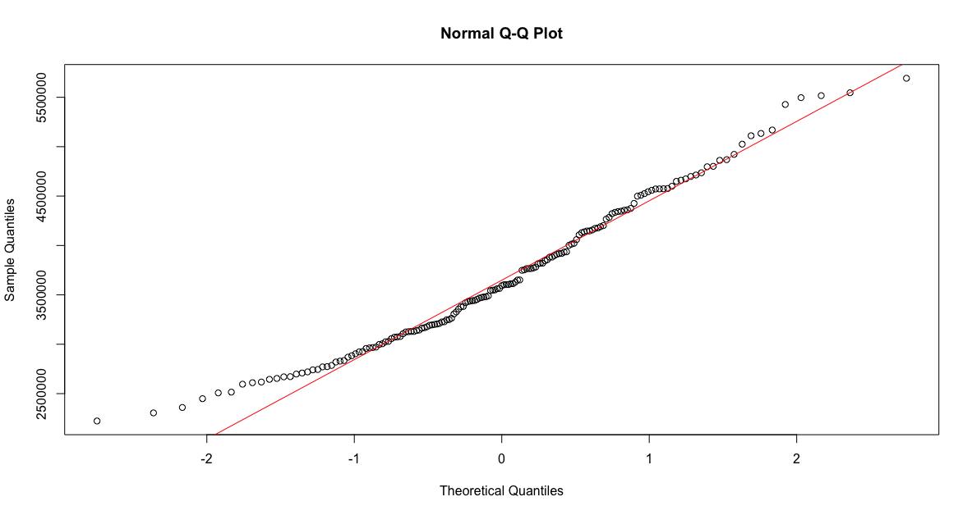
Normal Probability Plots (QQ plots)

Slide 8
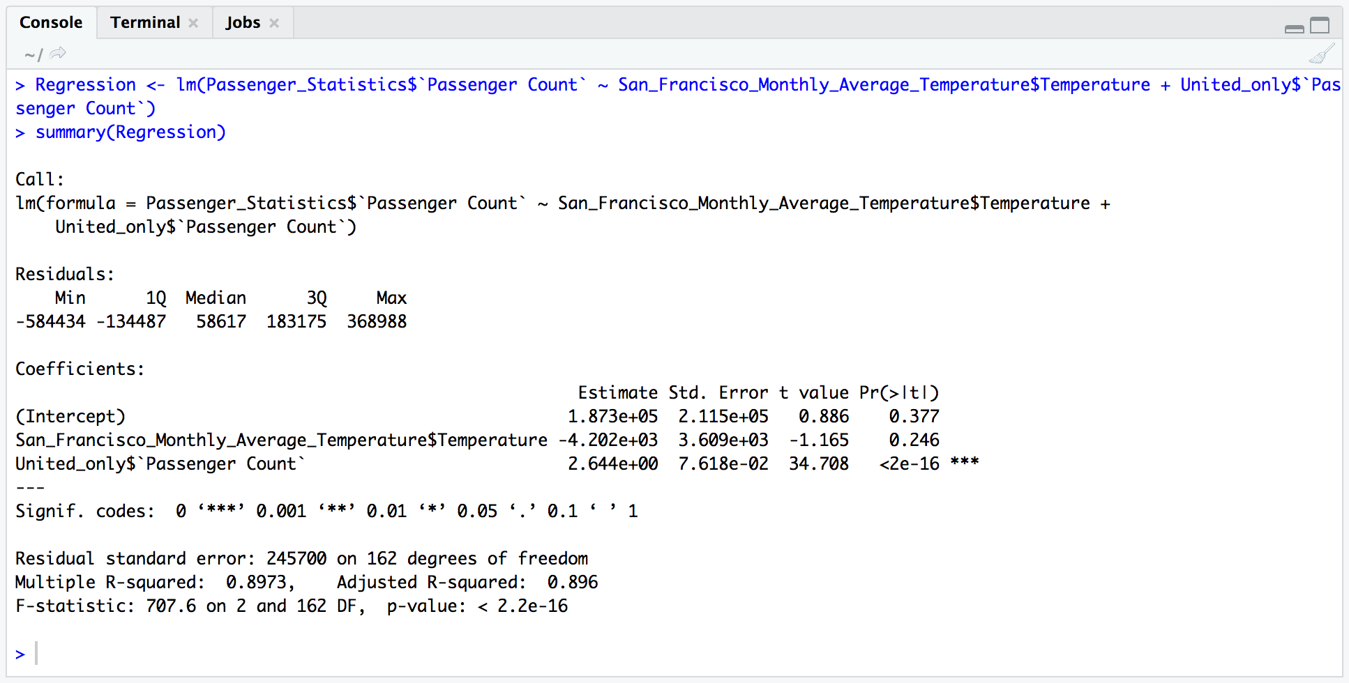
Linear Regression

Slide 9
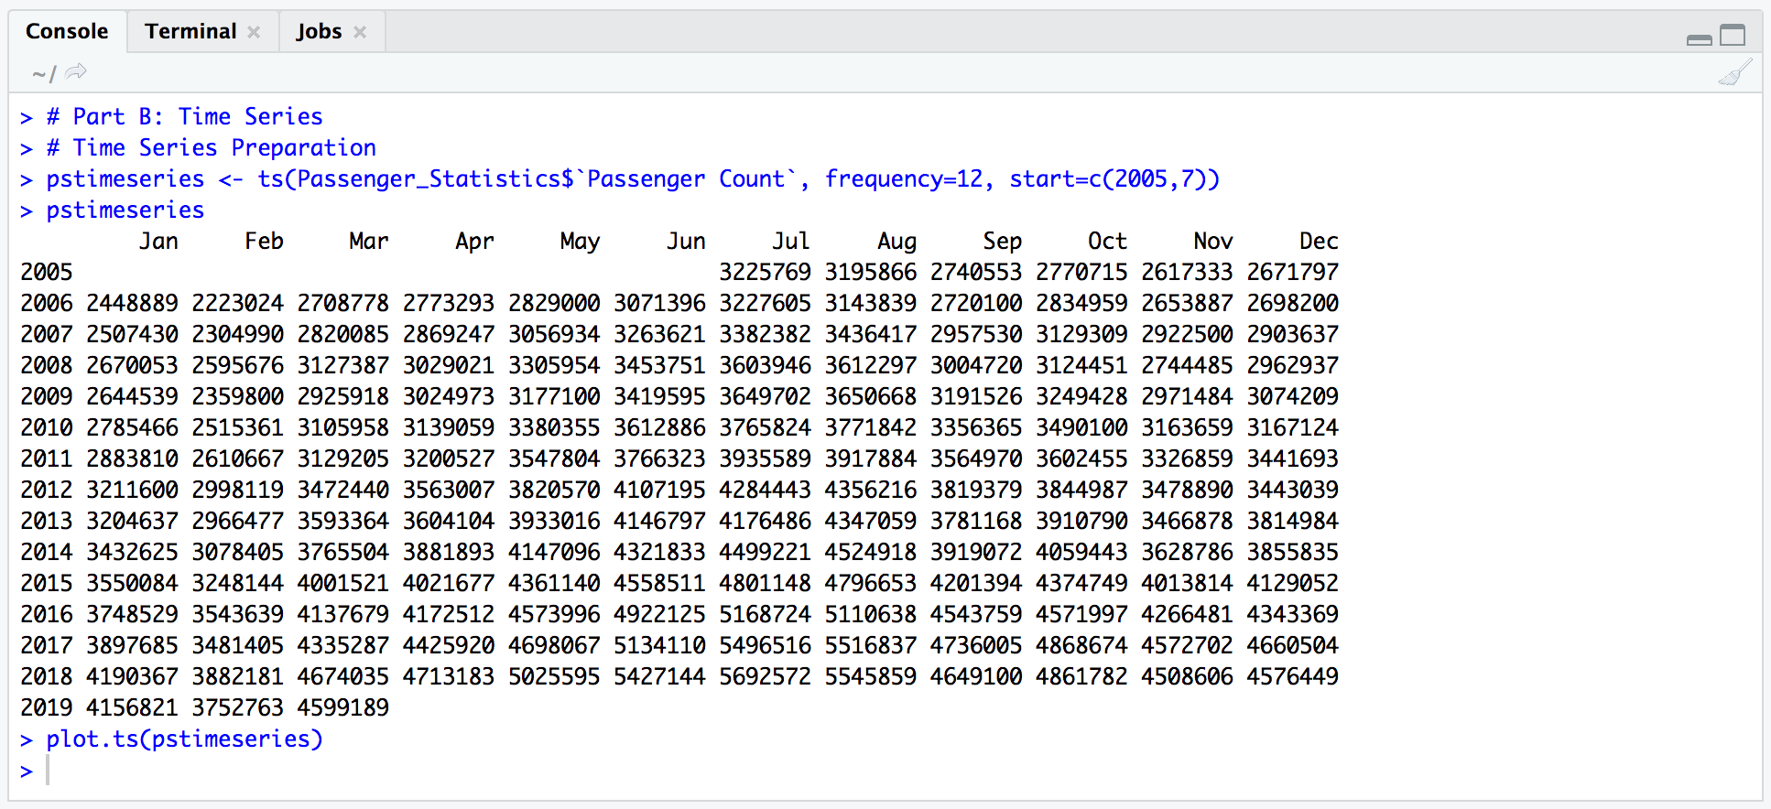
Time Series

Slide 10
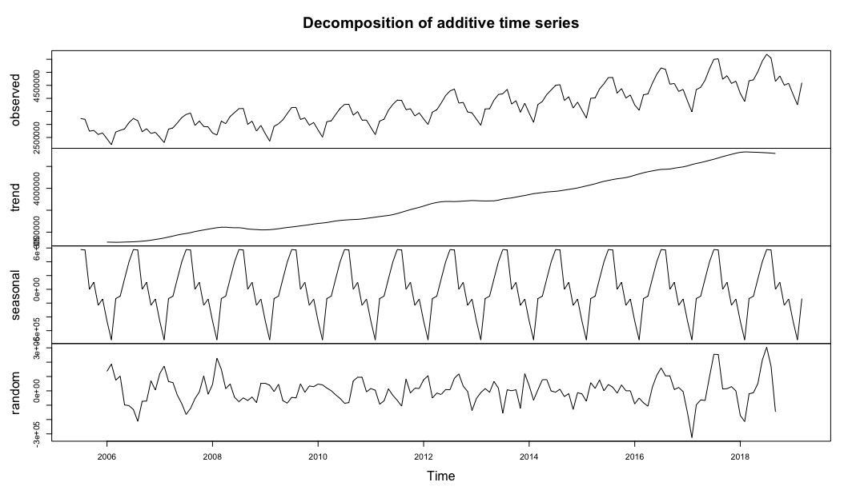
Decomposing

Slide 11
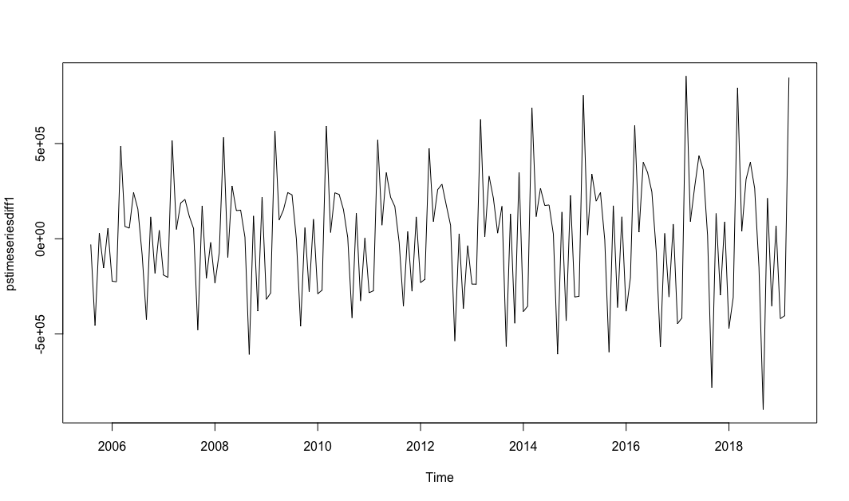
Differencing

Slide 12
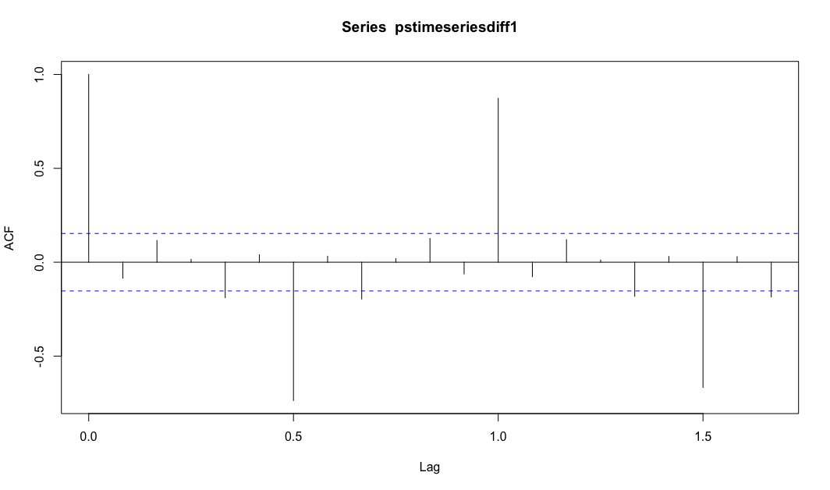
Selecting Candidates - ACF

Slide 13
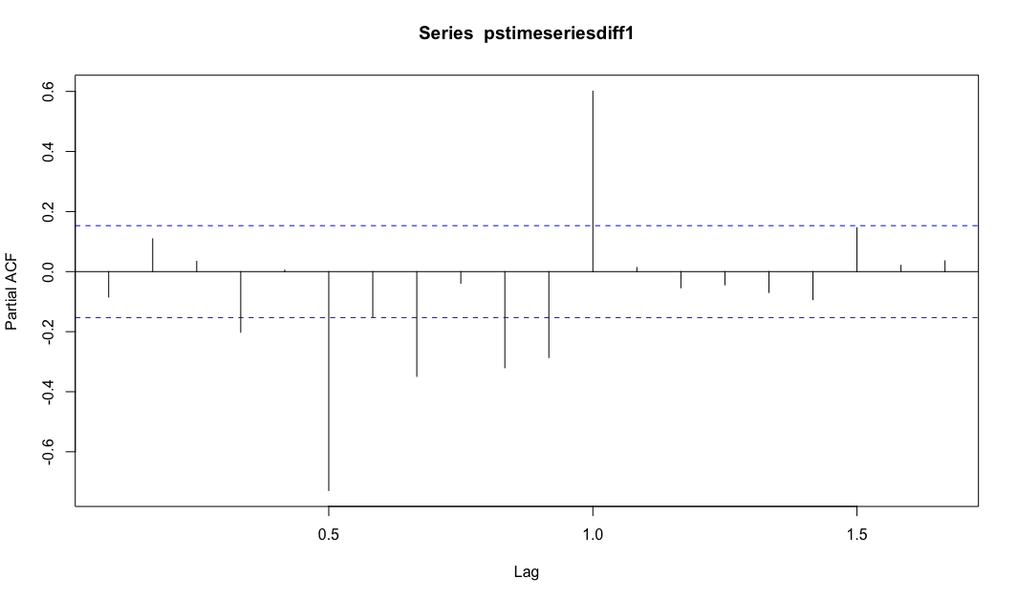
Selecting Candidates - PACF

Slide 14
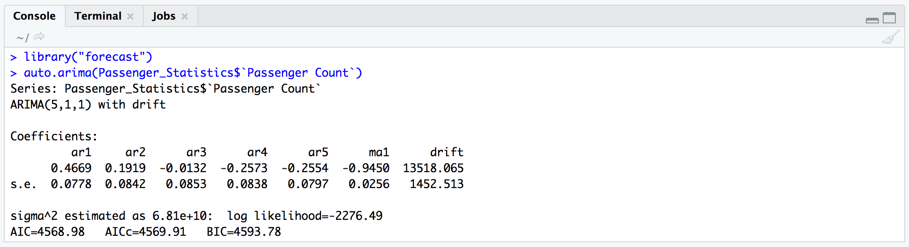
Auto.arima()

Slide 15

The end

